Slide 1
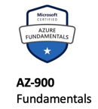
Purpose of this Lunch and Learn
Illustrate sample questions and question types for AZ-900 Certification
Help you overcome your fear of this exam by showing you the kind of questions and what to expect on the exam and limiting the scope of material you need to study
Absolutely No Programming involved for this exam
Understand the obstacles to taking the exam
3 Steps - (1. sign up for Free Account & 2. Sign up for test & 3. Preparation)
Note: number of questions about Free Account on test
$200 free credit
No limit to what you can do (only you pay for what you do after the $200)
No Guaranteed Support
Provide a sample Study Technique for Rapid Learning AZ-900
Illustrate the simulator

Slide 2
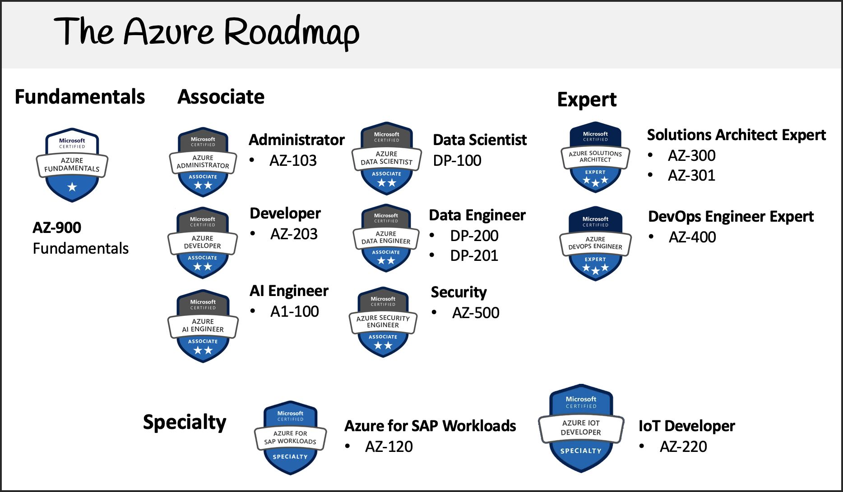

Slide 3
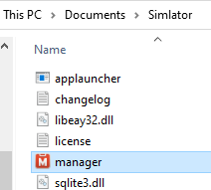
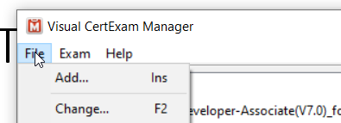
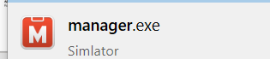
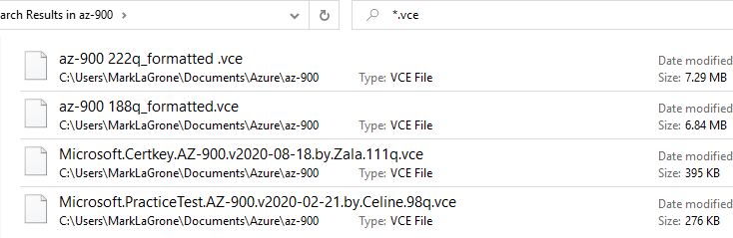
The Simulator
These files must all
Be in same directory
Add the vce files
Launches Simulator
Send me a gmail email and I will send you link to simulator, and vce files

Slide 4
The Simulator
These files must all
Be in same directory
Add the vce files
Launches Simulator
Send me a gmail email and I will send you link to simulator, and vce files

Slide 5
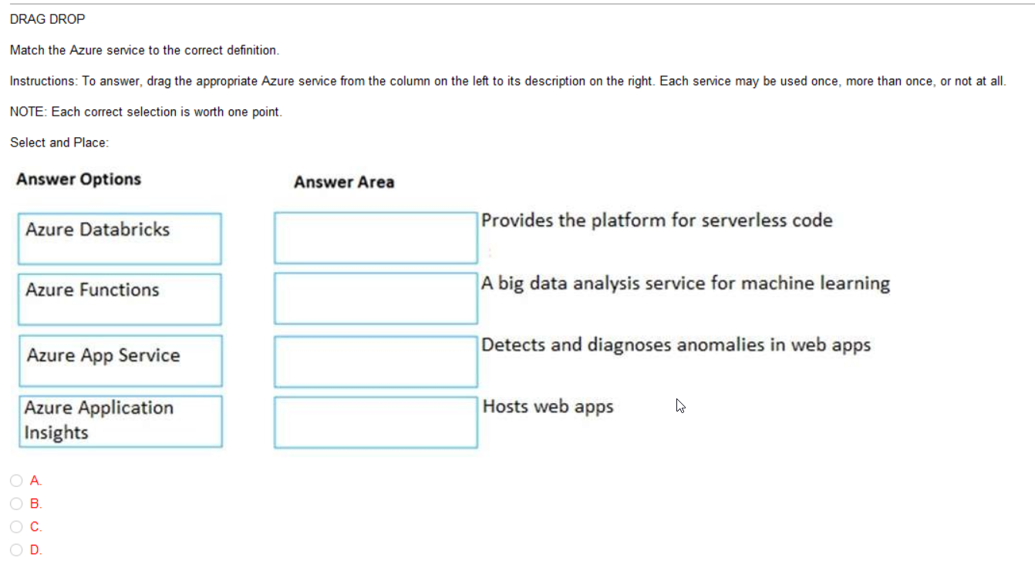

Slide 6
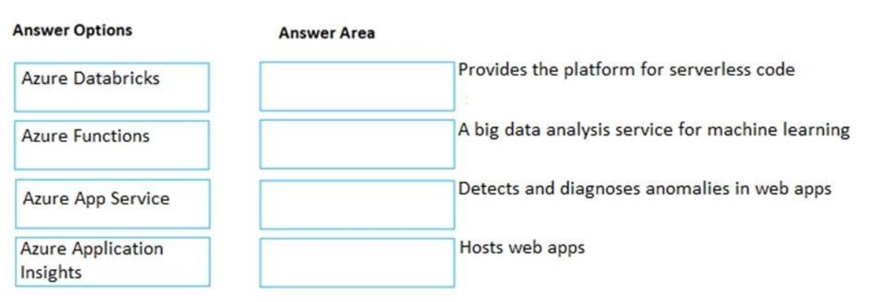
Azure Functions
Azure Databricks
Azure Application
Insights
Azure App Service

Slide 7
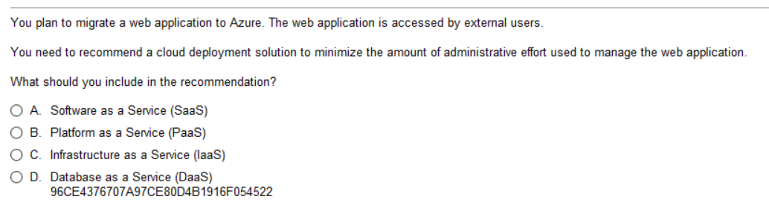
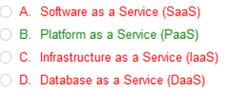
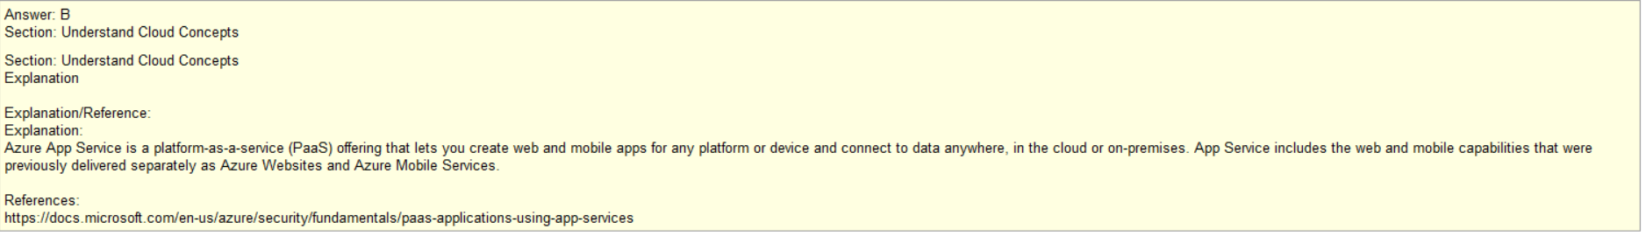
Admin effort
none
some
more
X
Tips: Lots of SaaS, PaaS, and IaaS questions on the exam, a key topic
Understand that IaaS requires HW and/or storage – ie VM, or Storage = IaaS
SaaS examples: Gmail
PaaS examples: Web App – They provide OS, and they provide the DMBS, you customize it with tables and queries

Slide 8
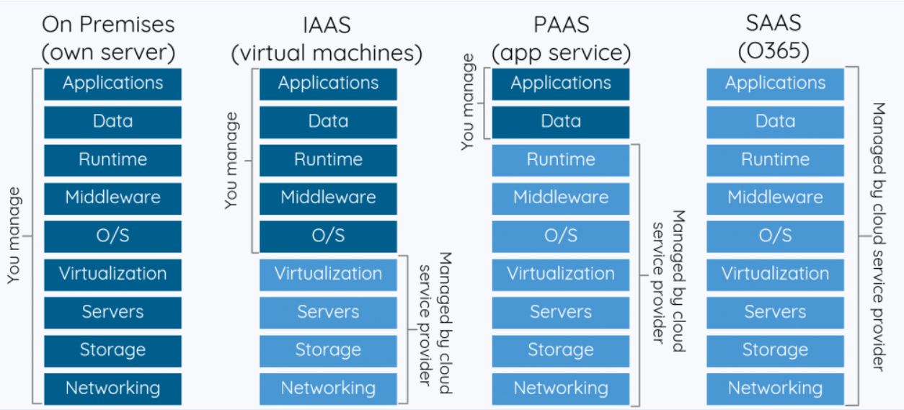
Significant Influence
Over Environment
Limited Influence
Over Environment
(Scaling, Location)
Zero Influence
Over Environment
Azure
You
DBMS
Note: Server vs Serverless
-totally stateless
-deployed on demand
-typically small footprint
Virtual Machine
Hard Drive/Space
DBMS (you install
And configure)
Azure Cosmos DB, App Service, CDN
Email
Office (Web)
www.Amazon.com

Slide 9
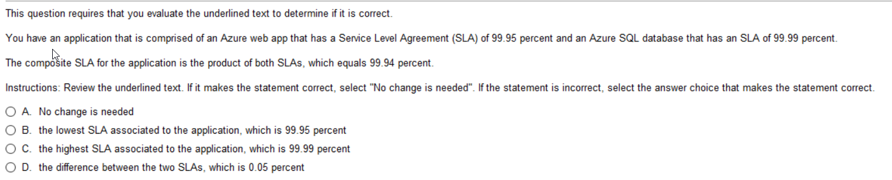
Composite = 99.95% x 99.99% = 99.94%

Slide 10
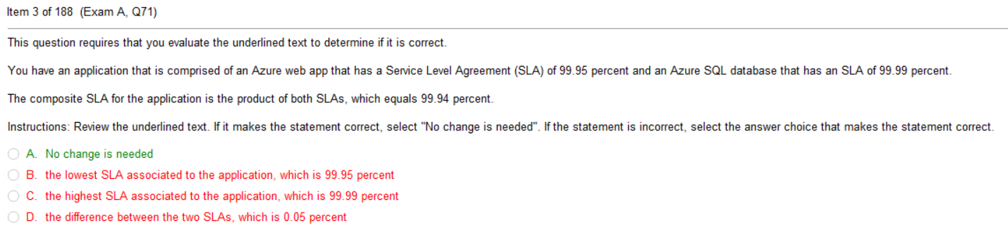
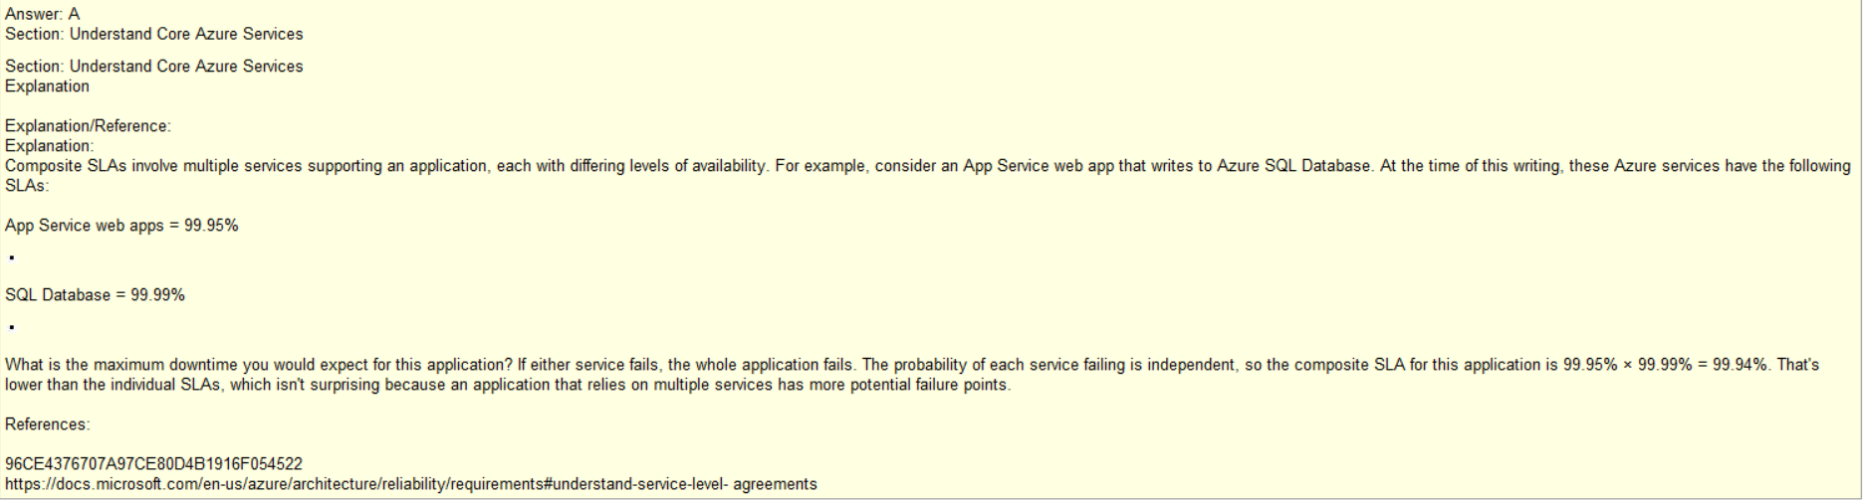

Slide 11
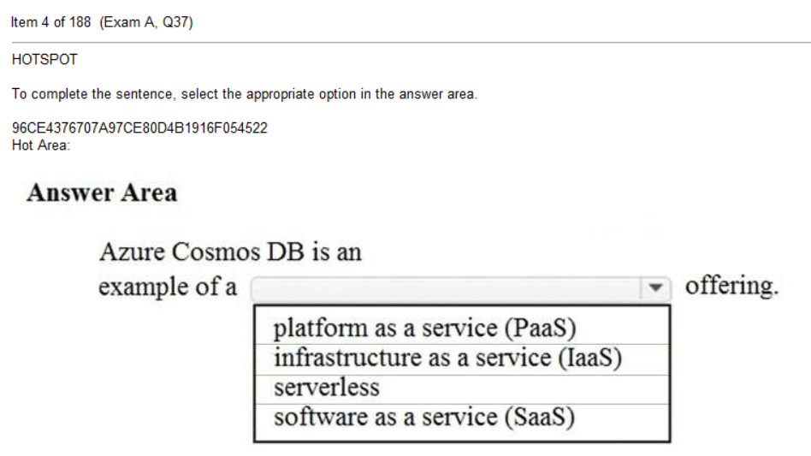

Slide 12
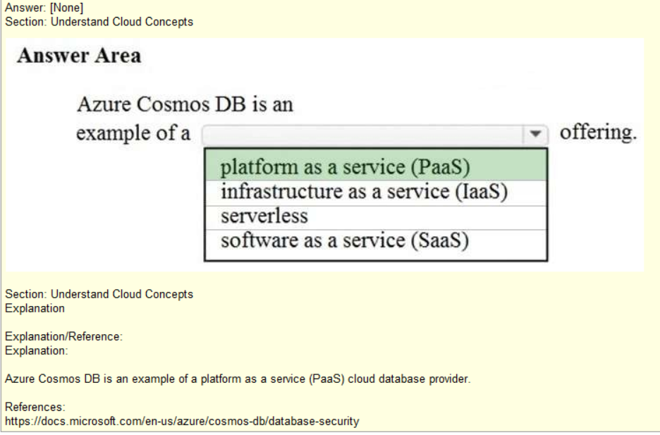

Slide 13
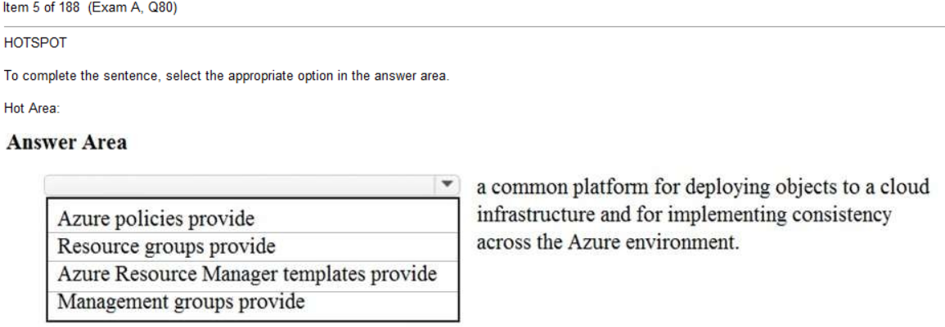

Slide 14
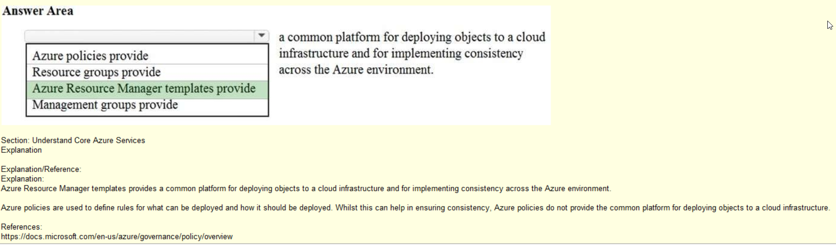
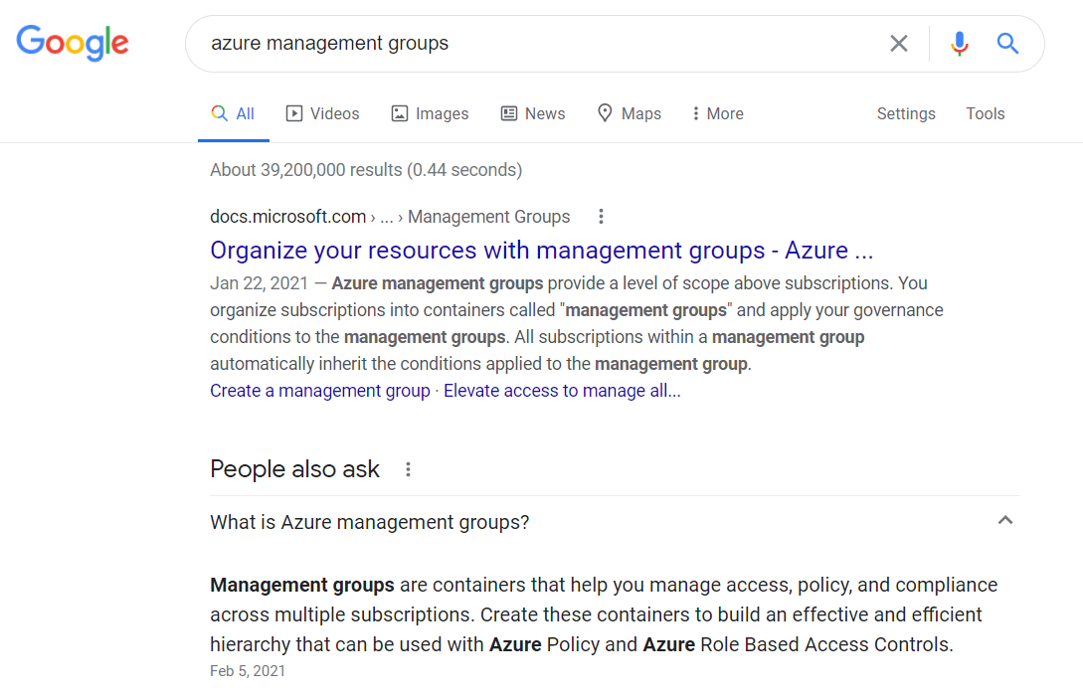

Slide 15
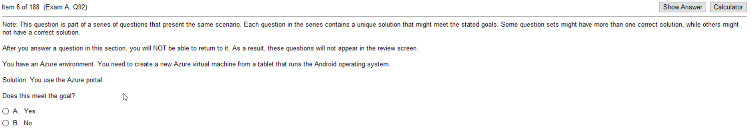
This is a concept that you will need to work through in your mind
Some can be initiated from PowerShell, others cannot.
All components be initiated from Azure Shell, Azure CLI, or Azure Console,
but Powershell is a Windows native thing, not a MAC or a Linux thing.
Best understood by going through ALL the questions in the simulator related to this.
There will be two or three questions about this topic on the exam.

Slide 16
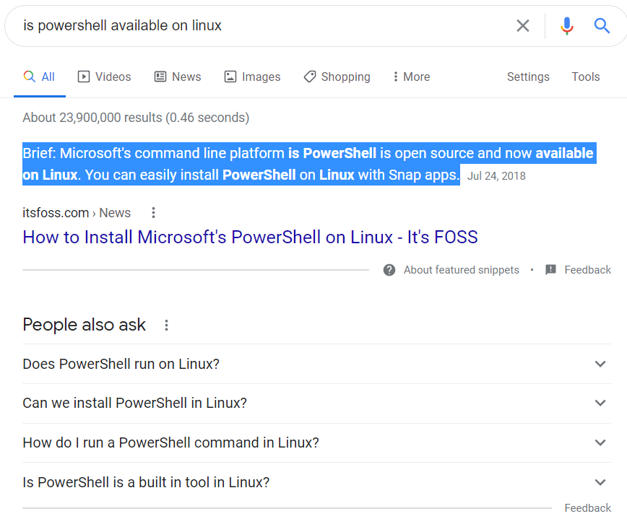
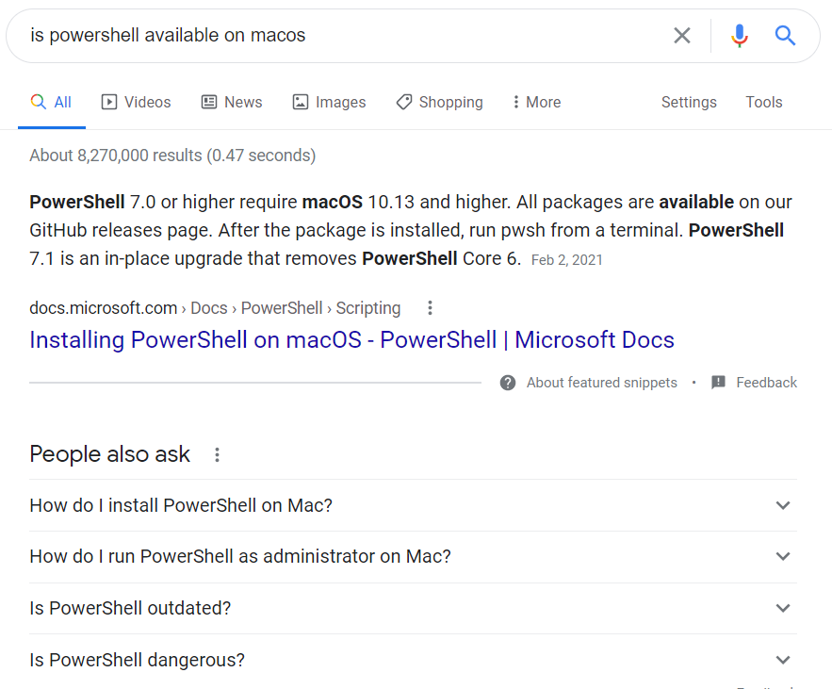
PowerShell can run on Linux – but don’t assume it is installed
by default as it is on Windows
PowerShell can run on MacOS – but don’t assume it is installed by default as it is on Windows
Plus: Somethings don’t work on PowerShell 6.

Slide 17
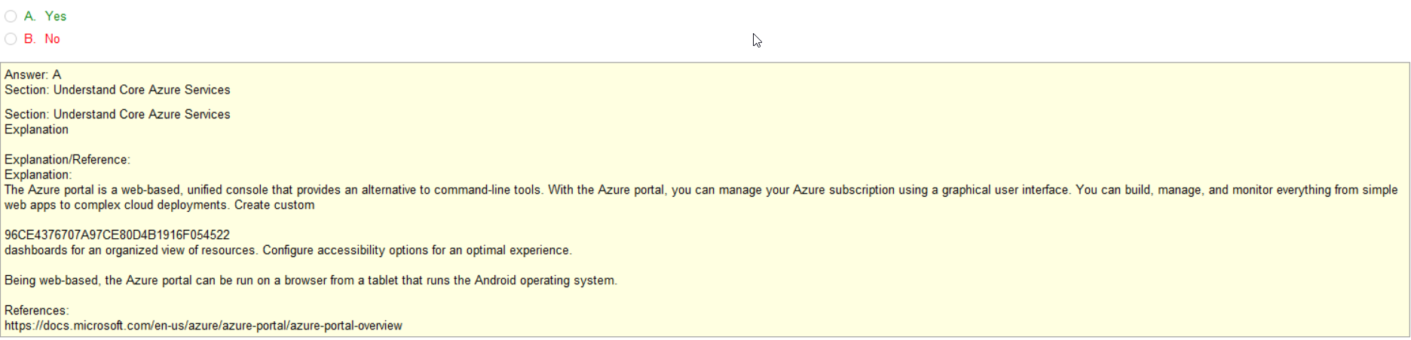
portal = web
Web accessible regardless of OS

Slide 18
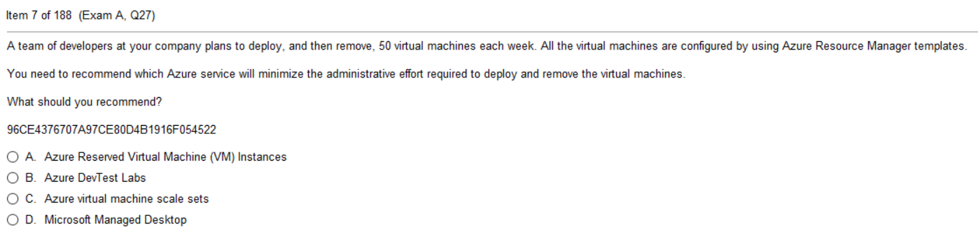
Note: Reserved vs pay-as-you-go – go lookup and read about it
Deploying, handled with the Resource Templates - Infrastructure as Code
Real-time Scaling, handled in the scaling options

Slide 19
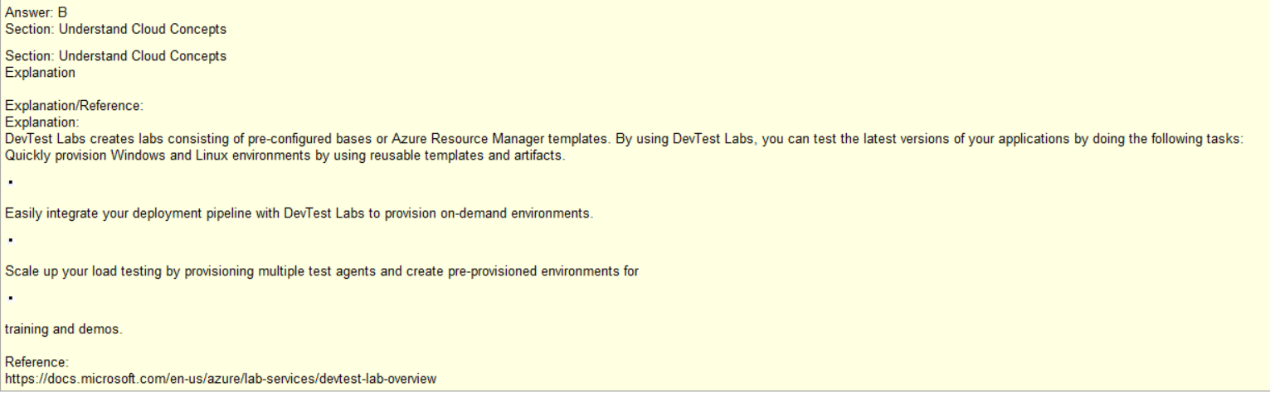

Slide 20
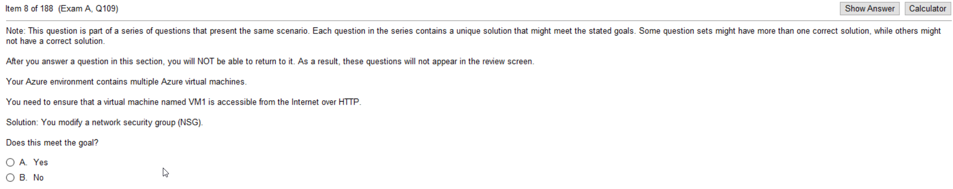

Slide 21
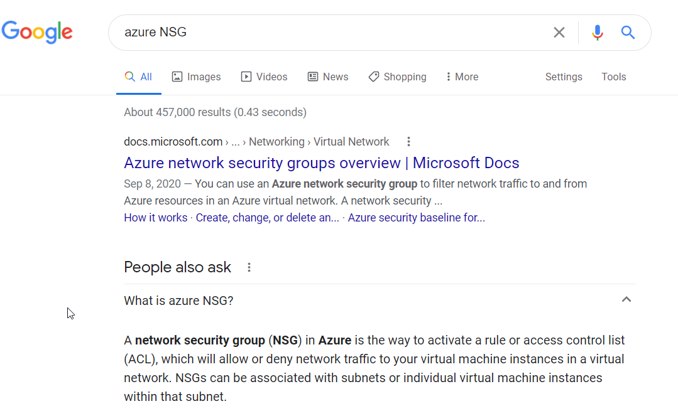
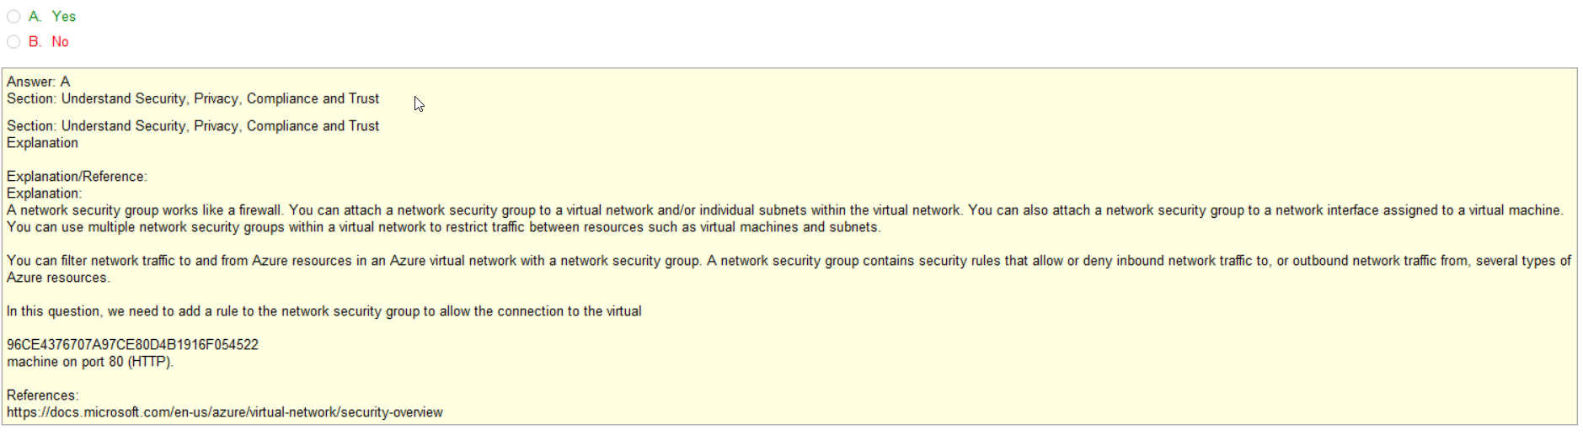

Slide 22
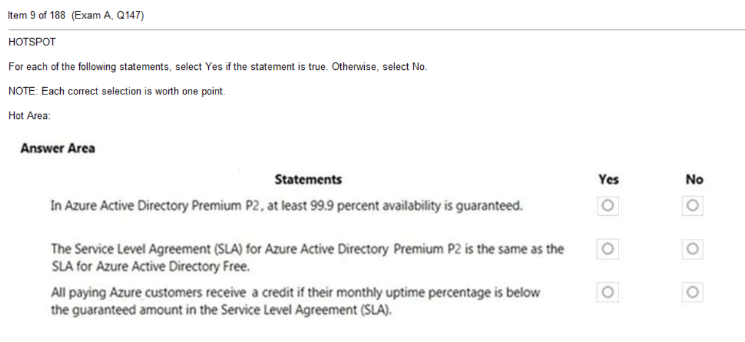
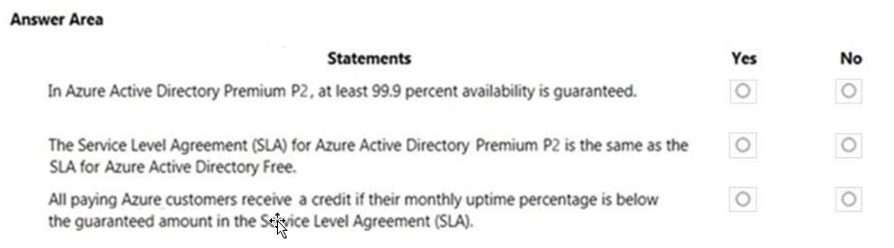
NOTE: Only Credit, no refunds

Slide 23
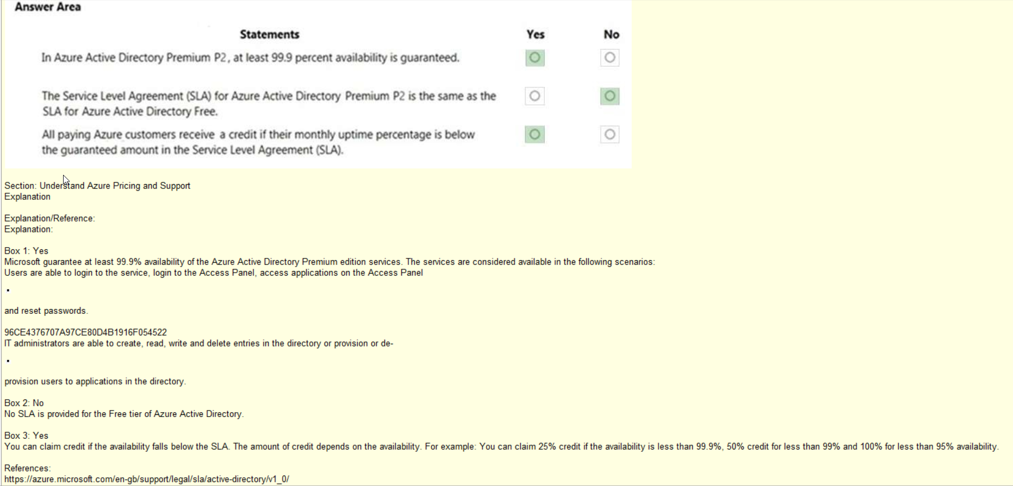

Slide 24
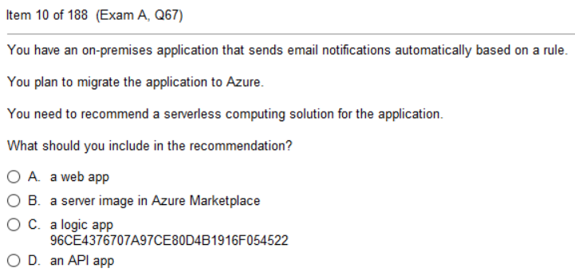

Slide 25
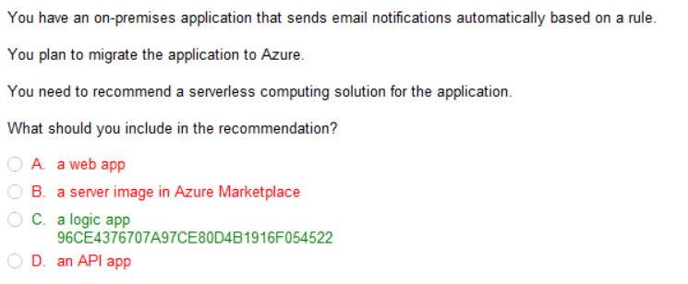
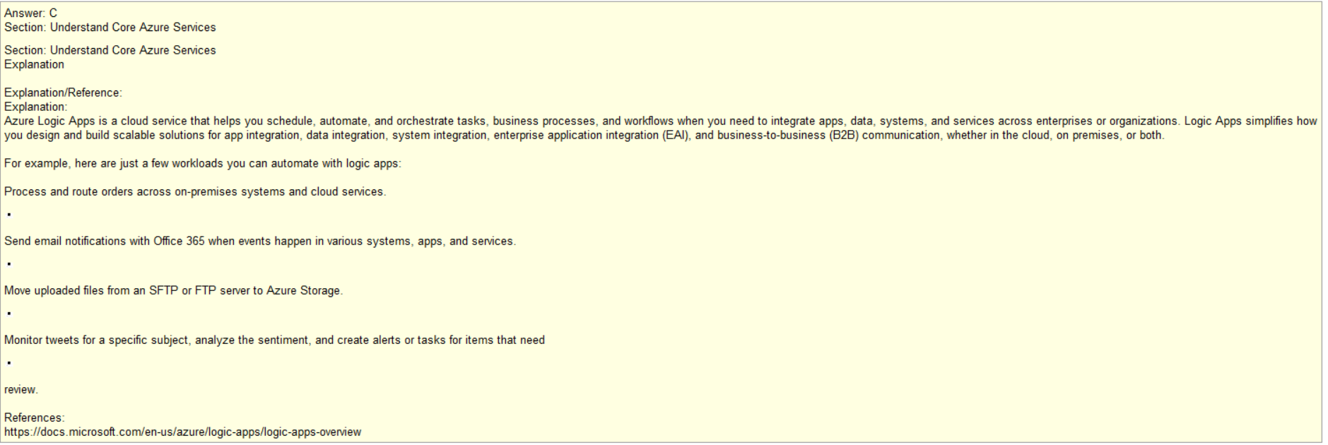
**Associated with Logic
Cloud Service
Serverless

Slide 26
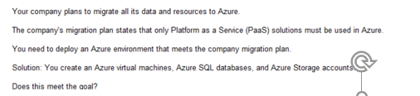
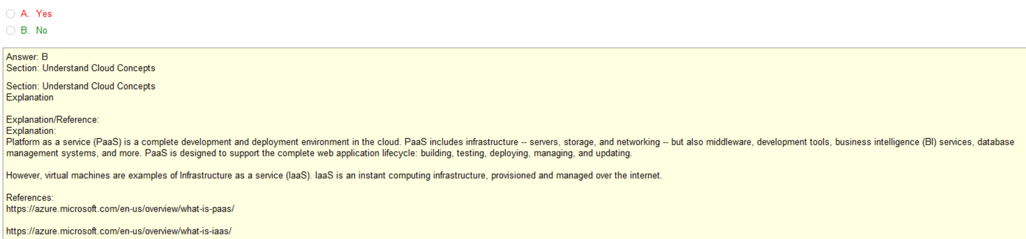
IaaS
PaaS
Unknown, but Storage would be considered IaaS

Slide 27
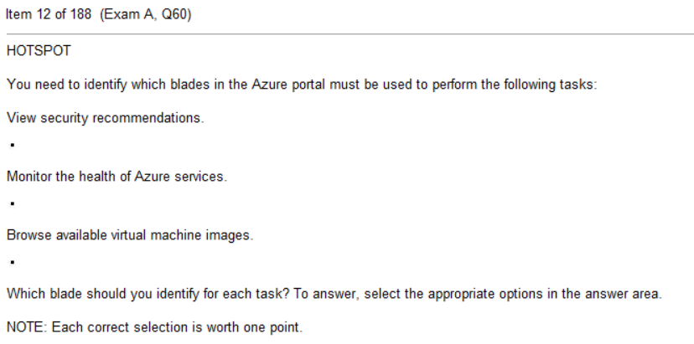
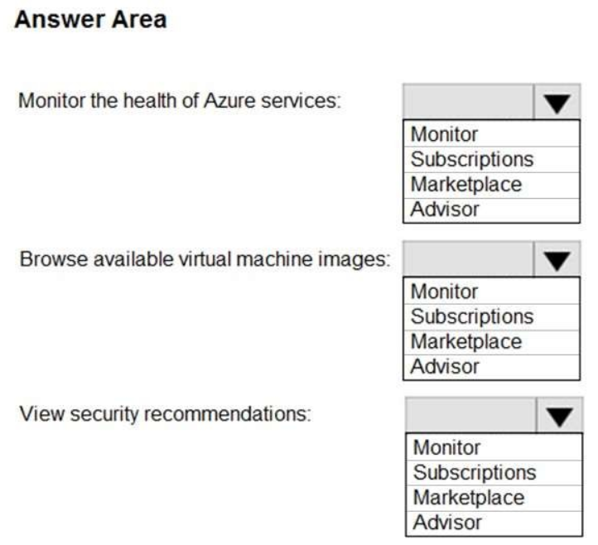

Slide 28
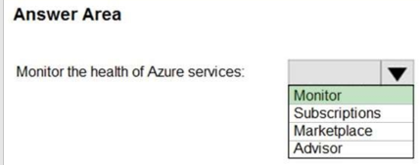
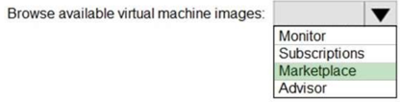
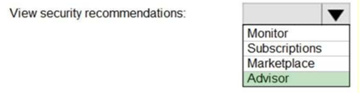
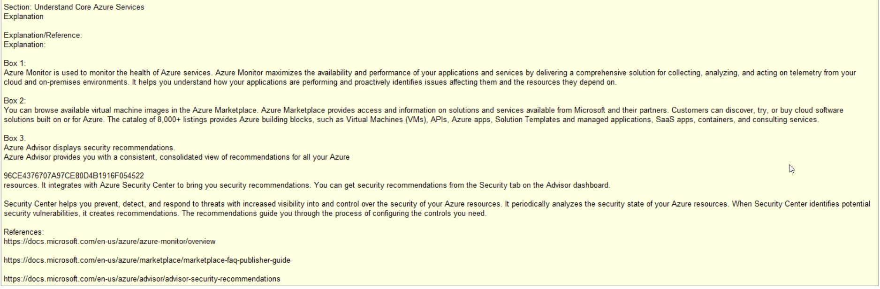
Tip: Read and fully understand
What Advisor does and can do

Slide 29
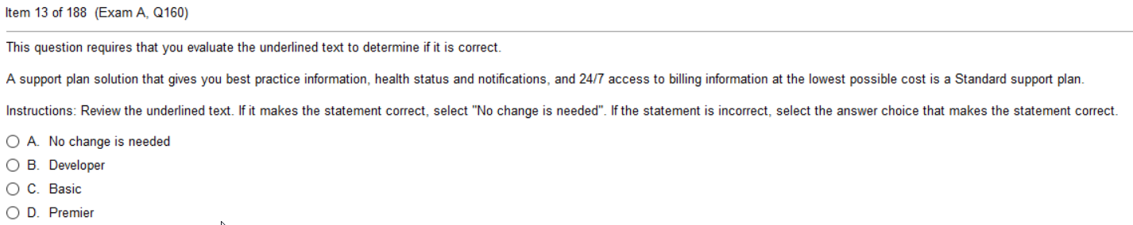
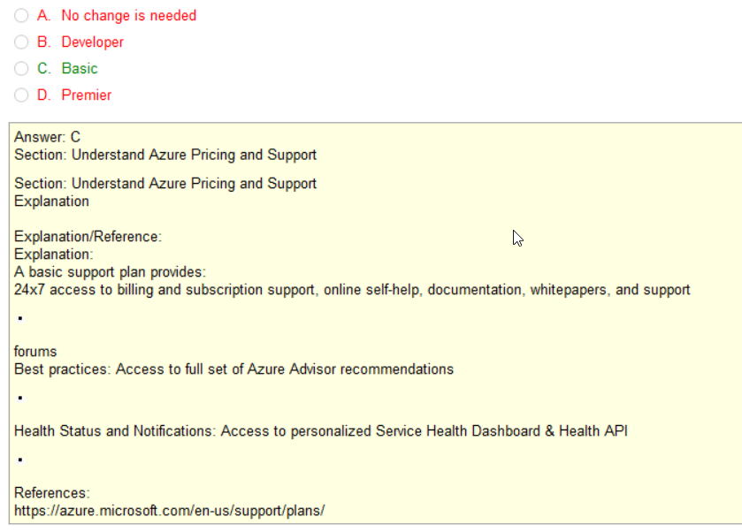
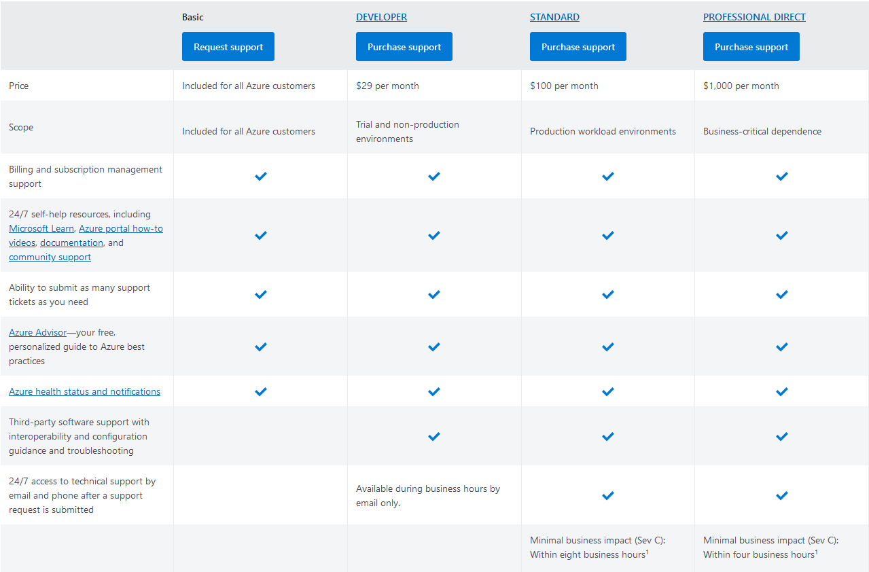
NOTE: You must absolutely
Understand all questions about the
Four diff Service Plans

Slide 30
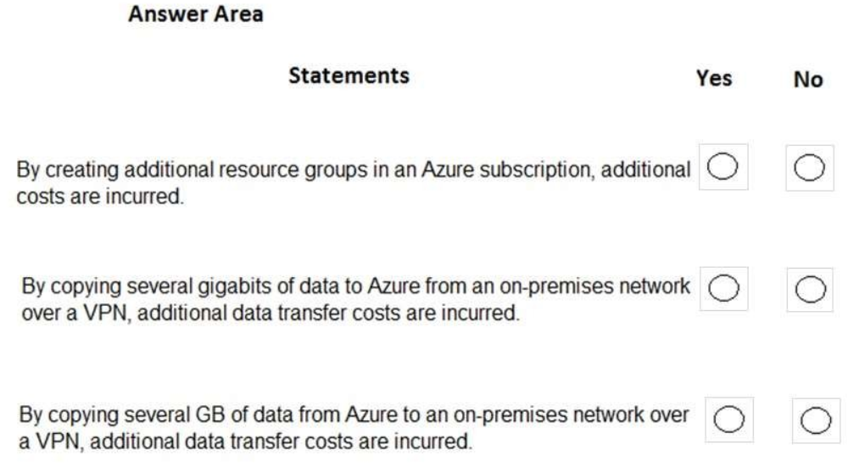

Slide 31
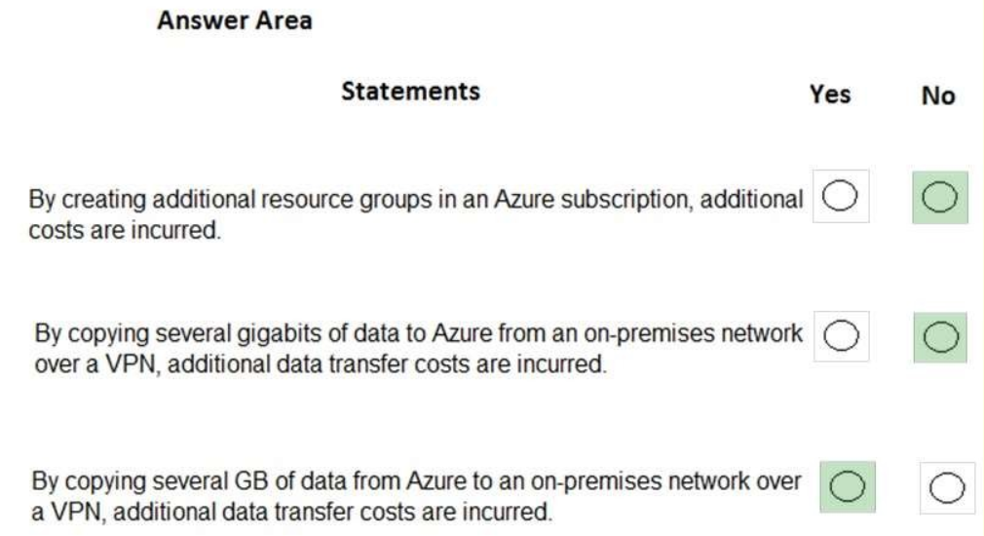
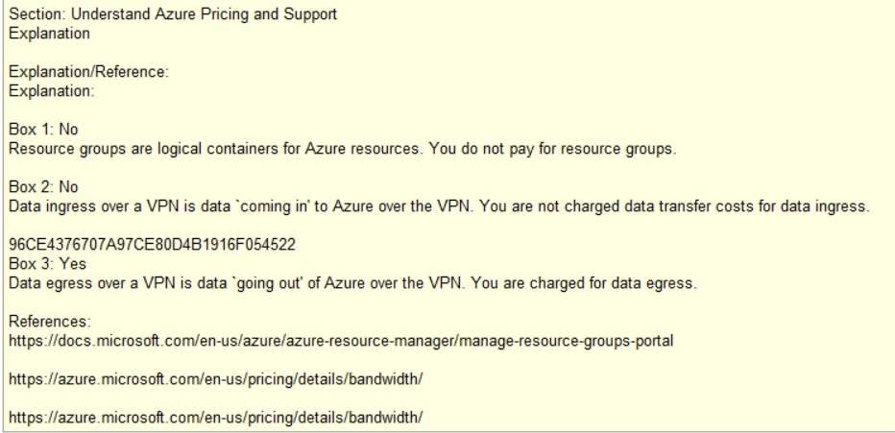

Slide 32
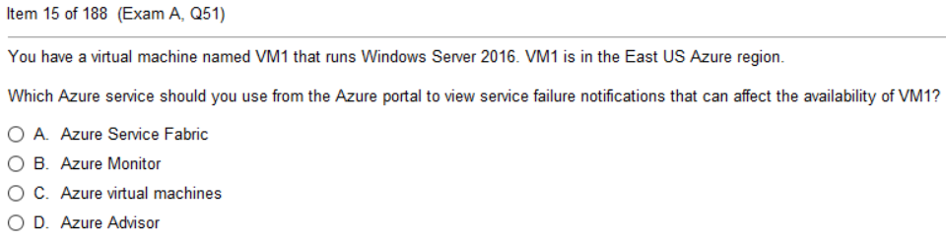
TIP: Understand Regions
Understand Availability Zones
Understand Data Centers
and relationship between them
Know what a Region Pair is
Not all Regions have Availability
DC (1 or more) < AZ (1 or more) < Region

Slide 33


Slide 34

Preview
There are two types of previews, private and public.
Private preview is only available to certain Azure customers for evaluation purposes.
The public preview is available to all Azure customers.
Azure may include preview, beta, or other pre-release features, services, software, or regions offered by Microsoft to obtain customer feedback ("Previews"). Previews are made available to you on the condition that you agree to these terms of use, which supplement your agreement governing use of Azure.
S
NO SLA, NO SUPPORT |
NO SLA, NO GUARANTEED SUPPORT |
SLA, SUPPORT
Public
Preview
Public
Private
Preview

Slide 35
Azure Traffic Manager
Azure Traffic Manager is a DNS-based traffic load balancer. This service allows you to distribute traffic to your public facing applications across the global Azure regions. ... The endpoint can be any Internet-facing service hosted inside or outside of Azure.
mywebsite.marklagrone.com
Hosted in California
Hosted in Germany
Hosted in New York

Slide 36
Azure Scale Set
What is azure scale set?
Azure virtual machine scale sets let you create and manage a group of load balanced VMs. ... Scale sets provide high availability to your applications, and allow you to centrally manage, configure, and update a large number of VMs.
Example: golfballs.com sells customized golfball. Normally 10 people concurrently at a time on their site.
They advertise during “The Masters”, suddenly 10,000 concurrent users. How do you accommodate this?
Have capacity to handle 1,000 users ALL THE TIME. Capacity to handle 9990 always on but not used.
Scaling sets that automatically grow capacity to 1000 concurrent users as needed. Assuming each machine uses
a virtual machine, then you could use a Virtual Scale set to grow the concurrent users up to 1000.

Slide 37

Recap: Use Google and Azure to lookup and help you
Remember what everything does
What is DDoS attack mean?
Distributed Denial of Service
Distributed Network Attacks are often referred to as Distributed Denial of Service (DDoS) attacks. ... The DDoS attack will send multiple requests to the attacked web resource – with the aim of exceeding the website's capacity to handle multiple requests… and prevent the website from functioning correctly.

Slide 38


ExpressRoute
Dedicated Link from your facility to Microsoft Cloud
Often implemented as MPLS circuit
MPLS
EXPRESSROUTE
Japan
Hawaii
Hamburg
London
MPLS
Dubai
Paris
NYC
Boston
Geneva

Slide 39

Analytics
Data
Lake
DB Logs
Data
Mart
DB Logs
DB
Related
Data
DB
DB
Data
Logs
Typically
Structured
Data
Financial
Reporting
Typically
Unstructured
Data
Anything
Everything
audio
email
Fits in
DBMS
DB Logs
Logs
audio
email

Slide 40
FIN

